Slide 1
Introduction to knowledge-based systems
Notes:
1

Slide 2
Overview of the course
This course is about
  knowledge-based systems
  expert systems
  knowledge systems.
  - three different terms which mean more or less the same thing.
One could also say that it is about applied artificial intelligence.
Notes:
2

Slide 3
KBSs & Knowledge
What is a knowledge-based system?
  A system which is built around a knowledge base. i.e. a collection of knowledge, taken from a human, and stored in such a way that the system can reason with it.
What is knowledge?
  Knowledge is the sort of information that people use to solve problems.
Notes:
3

Slide 4
Knowledge
Knowledge includes:
  facts, concepts, procedures, models, heuristics, examples.
Knowledge may be:
  specific or general
  exact or fuzzy
  procedural or declarative
Notes:
4

Slide 5
Expert systems
What is an expert system?
  A particular kind of knowledge-based system
  One in which the knowledge, stored in the knowledge base, has been taken from an expert in some particular field.
Therefore, an expert system can, to a certain extent, act as a substitute for the expert from whom the knowledge was taken.
Notes:
5

Slide 6
Artificial intelligence
What is Artificial Intelligence?
Artificial Intelligence (AI) is concerned with exploring such aspects of human (and other animal) mental activity as:
  understanding  creativity
  perception  problem-solving
  consciousness  using language
  intelligence
by simulating them using computers.
Notes:
6

Slide 7
It is therefore closely connected with such social sciences as:
  psychology
  linguistics
  philosophy
Notes:
7

Slide 8
Applied artificial intelligence
What is applied AI?
Applied AI is concerned with producing software which is “intelligent”
It is intelligent in that it is based on what we know about human reasoning and other mental abilities
We are therefore talking about a branch of advanced computing - computer technology - rather than social science
Notes:
8

Slide 9
Knowledge engineering
The term “knowledge engineering” is often used to mean the process of
  designing
  building
  installing
an expert system or other knowledge-based system.
Some authors use the term to mean just the knowledge acquisition phase.
Notes:
9

Slide 10
Experts
An expert is an experienced practitioner in his/her particular field. More than that, he/she is a highly effective problem-solver and decision-taker in that field.
Experts have three qualities:
  They make good decisions
  They make those decisions quickly
  They are able to cope with a wide range of problems.
Notes:
10

Slide 11
As a result, they are valuable, highly-paid, and tend to be overworked.
Notes:
11

Slide 12
Experts and expert systems
Note that:
  The task that an expert system performs will generally be regarded as difficult.
  An expert system almost always operates in a rather narrow field of knowledge. The field of knowledge is called the knowledge domain of the system.
  There are many fields where expert systems can usefully be built.
  There are many fields where they can’t.
Notes:
12

Slide 13
Experts and expert systems
Note also that an expert can usually
  explain
  and
  justify
his/her decisions.
Notes:
13

Slide 14
Reasons for building an E.S.
One might build an expert system for any or all of the following reasons:
  To archive an expert’s knowledge, to insure against the day when he/she leaves, or retires, or dies.
  To disseminate his/her knowledge, so that it is available in more (possibly many more) places than the location of the expert.
  To ensure uniformity of advice/decisions.
  As a basis for training other specialists.
Notes:
14

Slide 15
Advantages of expert systems
Put another way, E.S. have the following advantages over human experts:
  The knowledge is permanent
  The knowledge is easily replicated
  The knowledge is represented explicitly, and can be evaluated
  The system is consistent - whereas human practitioners have bad days, computers don’t.
  Once built, running costs are low
Notes:
15

Slide 16
Disadvantages of expert systems
Developing an expert system usually costs a great deal of time & money
Historically, there has been a high failure rate in E.S. projects
  The project may well fail during development - most likely during the “knowledge acquisition” phase.
  The development may succeed, but the organisation may fail to accept and use the finished system.
Notes:
16

Slide 17
Disadvantages of expert systems
A human expert can update his/her knowledge in the light of
  Common sense
  Knowledge derived from other domain
  Contacts with other experts.
An expert system can’t.
Notes:
17

Slide 18
Choosing an E.S.project
Because of cost, and the danger of failure, it is important that E.S. projects are carefully chosen.
Notes:
18

Slide 19
Choosing an E.S.project
  The expense must be justified, in the light of the possible benefits.
  E.S. technology must be appropriate
    the right kind of expertise is involved
    it isn’t a problem which conventional programming could do better.
  Management, and the participants, must support the project fully.
Notes:
18

Slide 20
Types of expertise
Mike Greenwell’s classification of types of expertise, according to identifiable mental components of the skill (with examples):
[source: Greenwell (1988)]
Notes:
19

Slide 21
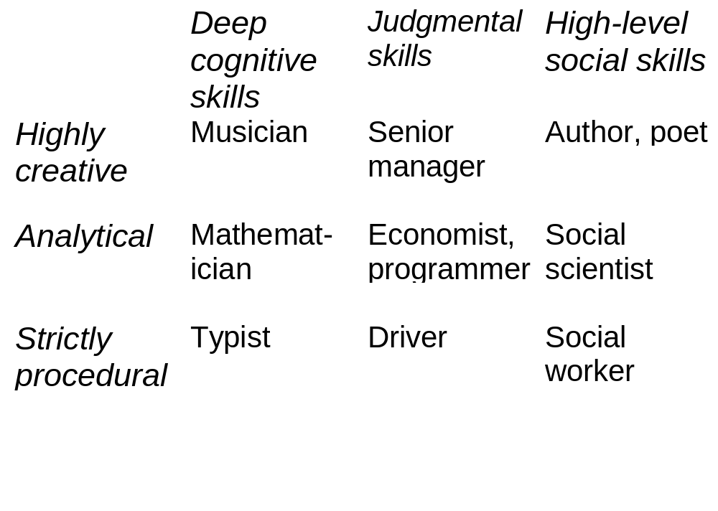
Types of expertise (with examples)
Notes:
20

Slide 22
Greenwell argues that only expertise which is judgmental and analytical, i.e. only the middle box of the nine, is worth capturing and including in an expert system.
Notes:
21

Slide 23
The phone call test
A rather simpler approach to answering the question which domains are worth building into an expert system?
“Any problem that can be and frequently is solved by your in-house expert in a 10-30 minute phone call can be automated as an expert system.”
Prof.Morris Firebaugh
Notes:
22

Slide 24
Possible expert systems - case histories
For discussion.
The following seven problem areas may, or may not, be suitable for computerisation as expert systems.
Notes:
23

Slide 25
Possible expert systems - case histories
A certain third world country has a large population, very few trained doctors, and insufficient resources to train many more. It is proposed to provide paramedics, who can be trained relatively cheaply and easily, with medical kits and portable PCs, each PC to be loaded with an expert system that can advise on the diagnosis and treatment of a variety of common diseases.
Notes:
24

Slide 26
Possible expert systems - case histories
The housing department in a provincial English town is overworked, although the staff turnover is quite low. Much of the work the staff do involves interviewing clients, and there is a clear pattern of questioning (which varies to a limited degree, depending on the circumstances of the client). It is proposed to build an expert system, which will direct the questioning process.
Notes:
25

Slide 27
Possible expert systems - case histories
A firm of wine importers relies heavily on its chief wine expert, who is skilled at selecting wines that are destined to be popular, on the basis of their taste, colour, scent etc. She is soon to retire. It is proposed to build an expert system that will enable any of several junior wine specialists to do her job.
Notes:
26

Slide 28
Possible expert systems - case histories
An education authority has a severe shortage of primary school teachers. It is proposed that an expert system should be built which can do the job of teaching English and arithmetic to five year old children.
Notes:
27

Slide 29
Possible expert systems - case histories
A software company proposes to build an expert system which can perform book-keeping for small commercial concerns.
Notes:
28

Slide 30
Possible expert systems - case histories
A large manufacturer of diesel electric locomotives has problems in providing enough maintenance personnel who are sufficiently skilled to locate faults in these (highly complex) locomotives. They propose to build an expert system which can perform fault location on such a machine.
Notes:
29

Slide 31
Possible expert systems - case histories
A mineral exploitation company wishes to extend its operations, which involve searching for hitherto undiscovered deposits of valuable metal ores. It is short of trained geologists. It proposes to build an expert system which can assess a geological site and come to a conclusion about how likely it is that there is a worthwhile mineral deposit there.
Notes:
30

